Slide 2
Topics
Graphical User Interfaces
Using the tkinter Module
Displaying Text with Label Widgets
Organizing Widgets with Frames
Button Widgets and Info Dialog Boxes
Getting Input with the Entry Widget
Using Labels as Output Fields
Radio Buttons and Check Buttons
ListBox Widgets
Drawing Shapes with the Canvas Widget

Slide 3
Graphical User Interfaces
User Interface: the part of the computer with which the user interacts
Command line interface: displays a prompt and the user types a command that is then executed
Graphical User Interface (GUI): allows users to interact with a program through graphical elements on the screen

Slide 4
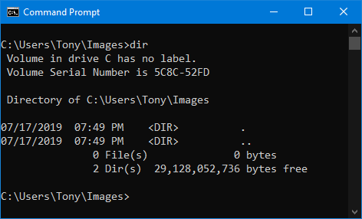
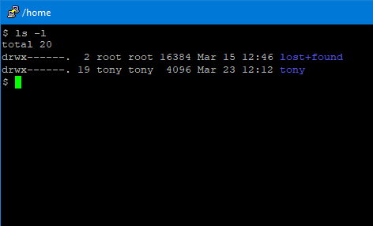
Graphical User Interfaces (cont’d.)
Command line interfaces
Windows
Linux

Slide 5
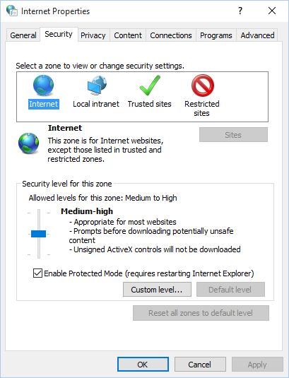
Graphical User Interfaces (cont’d.)
Dialog boxes: small windows that display information and allow the user to perform actions
  Responsible for most of the interaction through GUI
  User interacts with graphical elements such as icons, buttons, and slider bars

Slide 6
GUI Programs Are Event-Driven
In text-based environments, programs determine the order in which things happen
  The user can only enter data in the order requested by the program
GUI environment is event-driven
  The user determines the order in which things happen
    User causes events to take place and the program responds to the events

Slide 7
Using the tkinter Module
No GUI programming features built into Python
tkinter module: allows you to create simple GUI programs
  Comes with Python
Widget: graphical element that the user can interact with or view
  Presented by a GUI program

Slide 8
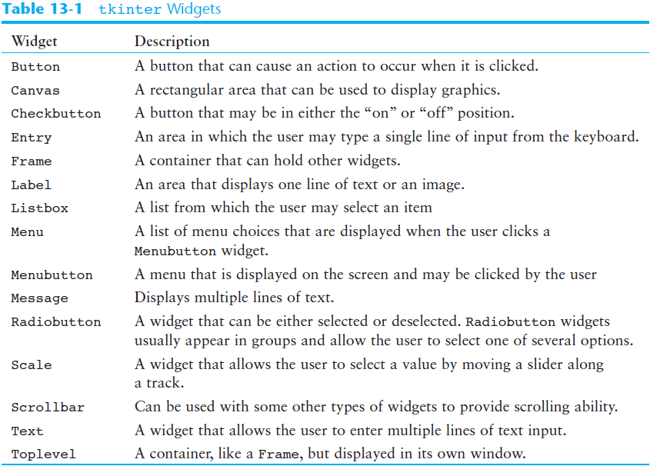

Slide 9
Using the tkinter Module (cont’d.)
Programs that use tkinter do not always run reliably under IDLE
  For best results run them from operating system command prompt
Most programmers take an object-oriented approach when writing GUI programs
  __init__ method builds the GUI
  When an instance is created the GUI appears on the screen

Slide 10
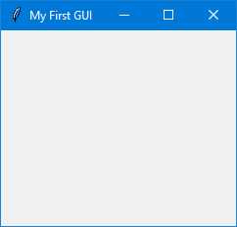
Example
1 # This program displays an empty window.
2
3 import tkinter
4
5 class MyGUI:
6 def __init__(self):
7 # Create the main window widget.
8 self.main_window = tkinter.Tk()
9
10 # Display a title.
11 self.main_window.title('My First GUI')
12
13 # Enter the tkinter main loop.
14 tkinter.mainloop()
15
16 # Create an instance of the MyGUI class.
17 if __name__ == '__main__':
18 my_gui = MyGUI()

Slide 11
Display Text with Label Widgets
Label widget: displays a single line of text in a window
  Made by creating an instance of tkinter module’s Label class
  Format: tkinter.Label(self.main_window, text = 'my text')
    First argument references the root widget, second argument shows text that should appear in label

Slide 12
Display Text with Label Widgets (cont’d.)
pack method: determines where a widget should be positioned and makes it visible when the main window is displayed
  Called for each widget in a window
  Receives an argument to specify positioning
    Positioning depends on the order in which widgets were added to the main window
    Valid arguments: side='top', side='left', side='right'

Slide 13

Example
self.label = tkinter.Label(self.main_window,
text='Hello World!')
self.label.pack()

Slide 14

Example
self.label1 = tkinter.Label(self.main_window,
text='Hello World!')
self.label2 = tkinter.Label(self.main_window,
text='This is my GUI program.')
self.label.pack()

Slide 15

Example
self.label1 = tkinter.Label(self.main_window,
text='Hello World!')
self.label2 = tkinter.Label(self.main_window,
text='This is my GUI program.')
self.label1.pack(side='left')
self.label2.pack(side='left')

Slide 16
Adding Borders to Labels
When creating a Label widget, you can use the borderwidth and relief arguments to display a border around the label
The borderwidth argument specifies the width of the border, in pixels
The relief argument specifies the border style

Slide 17

Example
self.label = tkinter.Label(self.main_window,
text='Hello World',
borderwidth=1,
relief='solid'

Slide 18

Example
self.label = tkinter.Label(self.main_window,
text='Hello World',
borderwidth=4,
relief='solid'

Slide 19
Values for relief Argument
relief Argument | Description
relief='flat' | The border is hidden and there is no 3D effect.
relief='raised' | The widget has a raised 3D appearance.
relief='sunken' | The widget has a sunken 3D appearance.
relief='ridge' | The border around the widget has a raised 3D appearance.
relief='solid' | The border appears as a solid line with no 3D effect.
relief='groove' | The border around the widget appears as a groove.

Slide 20
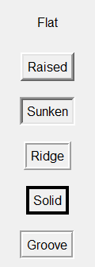
Values for relief Argument

Slide 21
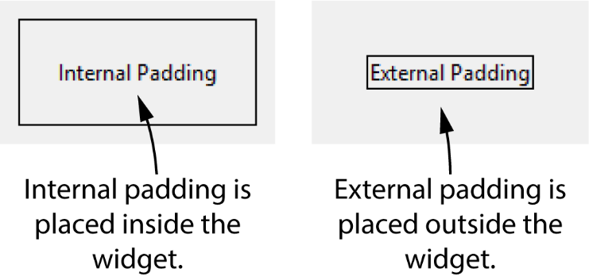
Padding
Padding: space that appears around a widget
  Internal padding appears around the inside edge of a widget
  External padding appears around the outside edge of a widget

Slide 22
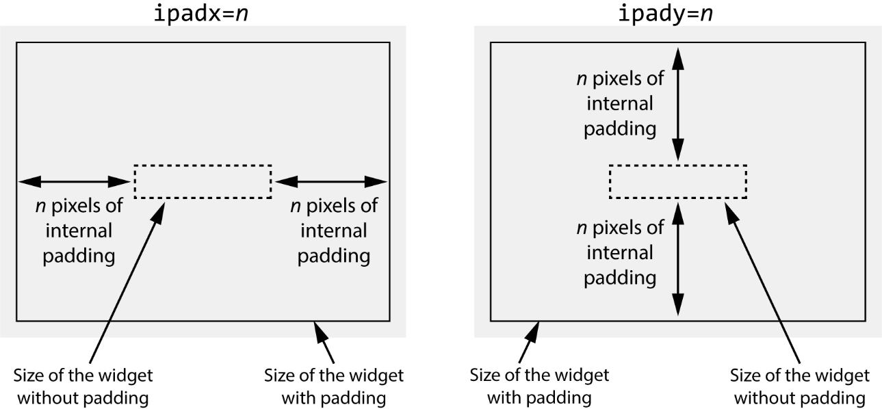
Internal Padding
To add horizontal internal padding to a widget, pass the argument ipadx=n to the widget's pack method
To add vertical internal padding to a widget, pass the argument ipady=n to the widget's pack method

Slide 23
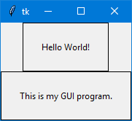
1 # This program demonstrates internal padding.
2 import tkinter
3
4 class MyGUI:
5 def __init__(self):
6 # Create the main window widget.
7 self.main_window = tkinter.Tk()
8
9 # Create two Label widgets with solid borders.
10 self.label1 = tkinter.Label(self.main_window,
11 text='Hello World!',
12 borderwidth=1,
13 relief='solid')
14
15 self.label2 = tkinter.Label(self.main_window,
16 text='This is my GUI program.',
17 borderwidth=1,
18 relief='solid')
19
20 # Display the Labels with 20 pixels of horizontal
21 # and vertical internal padding.
22 self.label1.pack(ipadx=20, ipady=20)
23 self.label2.pack(ipadx=20, ipady=20)
24
25 # Enter the tkinter main loop.
26 tkinter.mainloop()
27
28 # Create an instance of the MyGUI class.
29 if __name__ == '__main__':
30 my_gui = MyGUI()

Slide 24
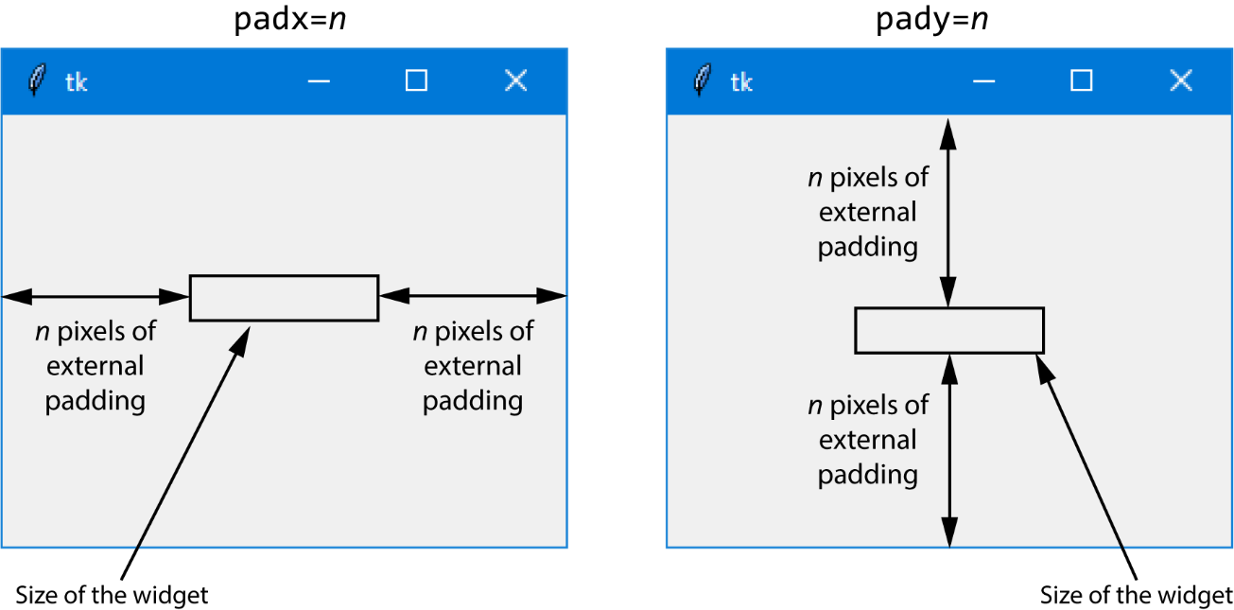
External Padding
To add horizontal external padding to a widget, pass the argument padx=n to the widget's pack method
To add vertical external padding to a widget, pass the argument pady=n to the widget's pack method

Slide 25
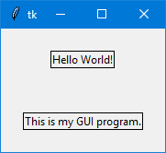
1 # This program demonstrates external padding.
2 import tkinter
3
4 class MyGUI:
5 def __init__(self):
6 # Create the main window widget.
7 self.main_window = tkinter.Tk()
8
9 # Create two Label widgets with solid borders.
10 self.label1 = tkinter.Label(self.main_window,
11 text='Hello World!',
12 borderwidth=1,
13 relief='solid')
14
15 self.label2 = tkinter.Label(self.main_window,
16 text='This is my GUI program.',
17 borderwidth=1,
18 relief='solid')
19
20 # Display the Labels with 20 pixels of horizontal
21 # and vertical external padding.
22 self.label1.pack(padx=20, pady=20)
23 self.label2.pack(padx=20, pady=20)
24
25 # Enter the tkinter main loop.
26 tkinter.mainloop()
27
28 # Create an instance of the MyGUI class.
29 if __name__ == '__main__':
30 my_gui = MyGUI()

Slide 26
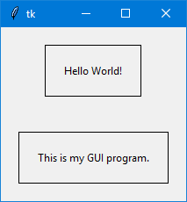
1 # This program demonstrates both internal and external padding.
2 import tkinter
3
4 class MyGUI:
5 def __init__(self):
6 # Create the main window widget.
7 self.main_window = tkinter.Tk()
8
9 # Create two Label widgets with solid borders.
10 self.label1 = tkinter.Label(self.main_window,
11 text='Hello World!',
12 borderwidth=1,
13 relief='solid')
14
15 self.label2 = tkinter.Label(self.main_window,
16 text='This is my GUI program.',
17 borderwidth=1,
18 relief='solid')
19
20 # Display the Labels with 20 pixels of horizontal
21 # and vertical external padding.
22 self.label1.pack(ipadx=20, ipady=20, padx=20, pady=20)
23 self.label2.pack(ipadx=20, ipady=20, padx=20, pady=20)
24
25 # Enter the tkinter main loop.
26 tkinter.mainloop()
27
28 # Create an instance of the MyGUI class.
29 if __name__ == '__main__':
30 my_gui = MyGUI()

Slide 27
Organizing Widgets with Frames
Frame widget: container that holds other widgets
  Useful for organizing and arranging groups of widgets in a window
  The contained widgets are added to the frame widget which contains them
    Example:
    tkinter.Label(self.top_frame, text = 'hi')

Slide 28
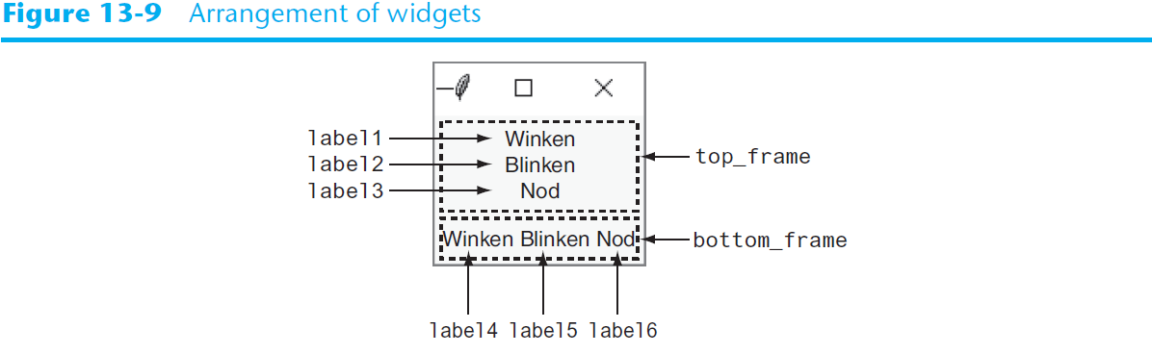
Organizing Widgets with Frames (cont’d.)

Slide 29
Button Widgets and Info Dialog Boxes
Button widget: widget that the user can click to cause an action to take place
  When creating a button can specify:
    Text to appear on the face of the button
    A callback function
Callback function: function or method that executes when the user clicks the button
  Also known as an event handler

Slide 30
Button Widgets and Info Dialog Boxes (cont’d.)
Info dialog box: a dialog box that shows information to the user
  Format for creating an info dialog box:
    Import tkinter.messagebox module
    tkinter.messagebox.showinfo(title,
    message)
      title is displayed in dialog box’s title bar
      message is an informational string displayed in the main part of the dialog box

Slide 31
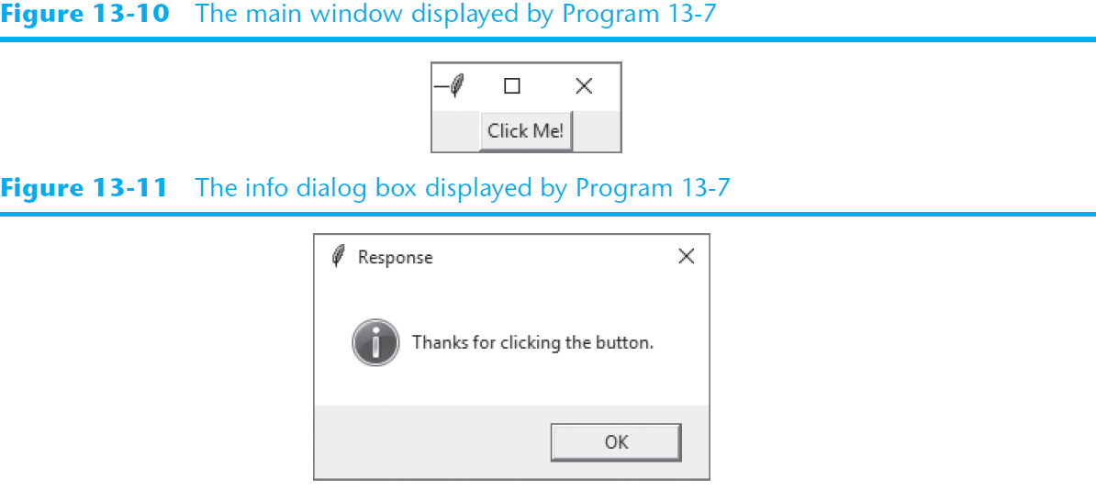
Button Widgets and Info Dialog Boxes (cont’d.)

Slide 32
Creating a Quit Button
Quit button: closes the program when the user clicks it
To create a quit button in Python:
  Create a Button widget
  Set the root widget’s destroy method as the callback function
    When the user clicks the button the destroy method is called and the program ends

Slide 33
Getting Input with the Entry Widget
Entry widget: rectangular area that the user can type text into
  Used to gather input in a GUI program
  Typically followed by a button for submitting the data
    The button’s callback function retrieves the data from the Entry widgets and processes it
  Entry widget’s get method: used to retrieve the data from an Entry widget
    Returns a string

Slide 34
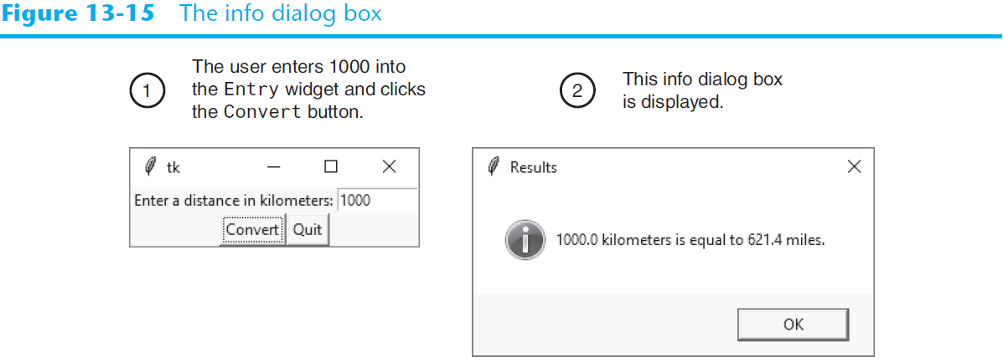
Getting Input with the Entry Widget (cont’d.)

Slide 35
Using Labels as Output Fields
Can use Label widgets to dynamically display output
  Used to replace info dialog box
  Create empty Label widget in main window, and write code that displays desired data in the label when a button is clicked

Slide 36
Using Labels as Output Fields (cont’d.)
StringVar class: tkinter module class that can be used along with Label widget to display data
  Create StringVar object and then create Label widget and associate it with the StringVar object
  Subsequently, any value stored in the StringVar object with automatically be displayed in the Label widget

Slide 37
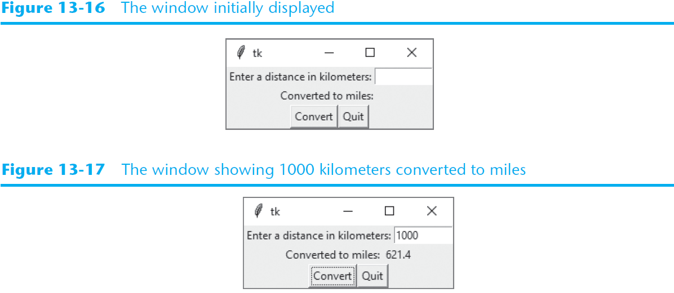
Using Labels as Output Fields (cont’d.)

Slide 38
Radio Buttons and Check Buttons
Radio button: small circle that appears filled when it is selected and appears empty when it is deselected
  Useful when you want the user to select one choice from several possible options
Radiobutton widgets: created using tkinter module’s Radiobutton class
  Radiobutton widgets are mutually exclusive
    Only one radio button in a container may be selected at any given time

Slide 39
Radio Buttons and Check Buttons (cont’d)
IntVar class: a tkinter module class that can be used along with Radiobutton widgets
  Steps for use:
    Associate group of Radiobutton widgets with the same IntVar object
    Assign unique integer to each Radiobutton
    When a Radiobutton widgets is selected, its unique integer is stored in the IntVar object
  Can be used to select a default radio button

Slide 40
Using Callback Functions with Radiobuttons
You can specify a callback function with Radiobutton widgets
  Provide an argument command=self.my_method when creating the Radiobutton widget
  The command will execute immediately when the radio button is selected
  Replaces the need for a user to click OK or submit before determining which Radiobutton is selected

Slide 41
Check Buttons
Check button: small box with a label appearing next to it; check mark indicates when it is selected
  User is allowed to select any or all of the check buttons that are displayed in a group
    Not mutually exclusive
Checkbutton widgets: created using tkinter module’s Checkbutton class
  Associate different IntVar object with each Checkbutton widget

Slide 42
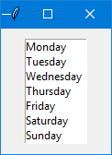
Listbox Widgets
A Listbox widget displays a list of items and allows the user to select one or more items

Slide 43
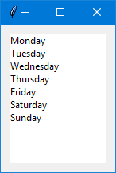
Example
1 # This program demonstrates a simple Listbox.
2 import tkinter
3
4 class ListboxExample:
5 def __init__(self):
6 # Create the main window.
7 self.main_window = tkinter.Tk()
8
9 # Create a Listbox widget.
10 self.listbox = tkinter.Listbox(self.main_window)
11 self.listbox.pack(padx=10, pady=10)
12
13 # Populate the Listbox with the data.
14 self.listbox.insert(0, 'Monday')
15 self.listbox.insert(1, 'Tuesday')
16 self.listbox.insert(2, 'Wednesday')
17 self.listbox.insert(3, 'Thursday')
18 self.listbox.insert(4, 'Friday')
19 self.listbox.insert(5, 'Saturday')
20 self.listbox.insert(6, 'Sunday')
21
22 # Start the main loop.
23 tkinter.mainloop()
24
25 # Create an instance of the ListboxExample class.
26 if __name__ == '__main__':
27 listbox_example = ListboxExample()

Slide 44
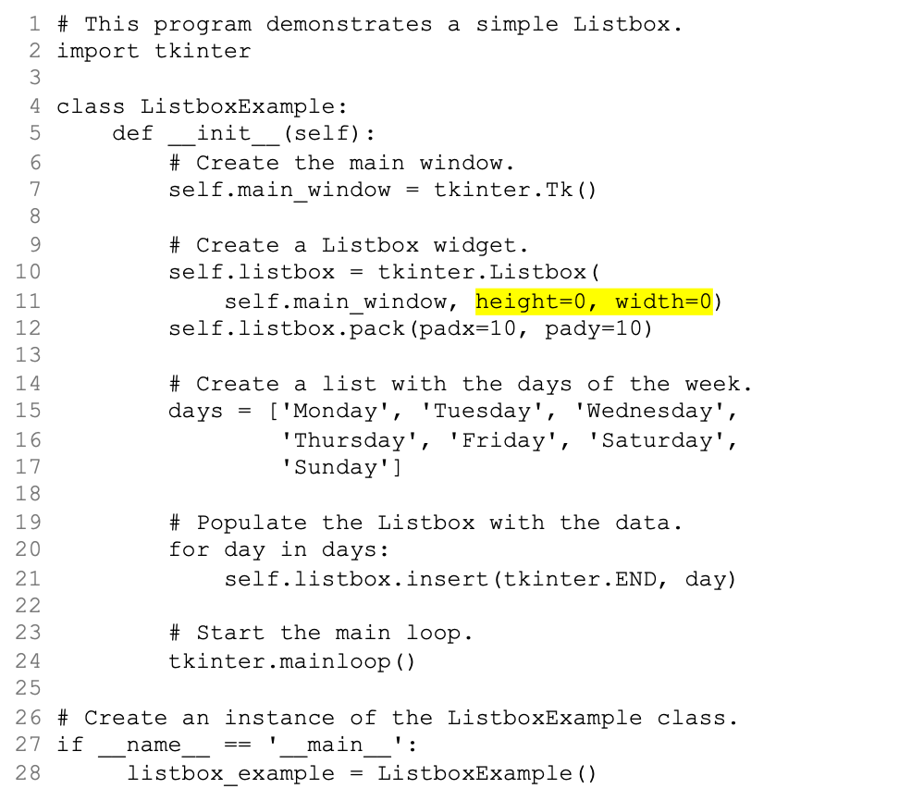
Specifying the Size of a Listbox

Slide 45
Selection Modes
Mode | Description
tkinter.BROWSE (This is the default mode) | The user can select one item at a time by clicking in the Listbox. Additionally, if the user clicks and drags the mouse inside the Listbox, the item that is currently under the cursor will be selected.
tkinter.EXTENDED | The user can select a group of adjacent items by clicking on the first item and dragging the mouse to the last item.
tkinter.MULTIPLE | Multiple items can be selected. When you click an unselected item, the item becomes selected. When you click a selected item, the item becomes unselected.
tkinter.SINGLE | The user can select one item at a time by clicking in the Listbox.

Slide 46
Retrieving the Selected Item(s)
The curselection method returns a tuple containing the indexes of the items that are currently selected in the Listbox
  If no item is selected, the tuple will be empty
  If an item is selected and the selection mode is tkinter.BROWSE or tkinter.SINGLE, the tuple will contain only one element
  If the Listbox's selection mode is tkinter.EXTENDED or tkinter.MULTIPLE, the tuple can contain multiple elements because those selection modes allow the user to select multiple items

Slide 47
Retrieving the Selected Item(s)
Once you have the index of the selected item, you can use the get method to retrieve the selected item or items from the Listbox
The get method accepts an integer index as its argument and returns the item that is located at that index in the Listbox

Slide 48
Examples
self.listbox = tkinter.Listbox(self.main_window)
(etc…)
index = self.listbox.curselection()
tkinter.messagebox.showinfo(self.listbox.get(index))
self.listbox = tkinter.Listbox(self.main_window,
selectmode=tkinter.EXTENDED)
(etc…)
indexes = self.listbox.curselection()
for i in indexes:
tkinter.messagebox.showinfo(self.listbox.get(i))

Slide 49
Listboxes and Callback Functions
You can optionally bind a callback function to a Listbox
When the user clicks an item in the Listbox, the callback function is immediately executed

Slide 50
Listboxes and Callback Functions
Example callback function:
  Assume listbox is a Listbox widget
  You must provide a parameter to accept an event object as an argument
def show_item(self, event):
index = self.listbox.curselection()
item = self.listbox.get(index)
tkinter.messagebox.showinfo('Selected Item', item)

Slide 51
Listboxes and Callback Functions
To bind the show_item function to the listbox widget:
Once done, the show_item function will execute whenever the user clicks an item in the listbox widget
self.listbox.bind('<<ListboxSelect>>', self.show_item)

Slide 52
Adding a Vertical Scrollbar to a Listbox
Create a frame to hold the Listbox and the scrollbar
Pack the frame
Create a Listbox inside the frame
Pack the Listbox to the left side of the frame
Create the vertical scrollbar inside the frame
Pack the scrollbar to the right side of the frame
Configure the scrollbar to call the Listbox's yview method when the slider knob is moved
Configure the Listbox to call the scrollbar's set method any time the Listbox is updated

Slide 53
Example
# Create the main window.
self.main_window = tkinter.Tk()
# Create a frame for the Listbox and vertical scrollbar.
self.listbox_frame = tkinter.Frame(self.main_window)
self.listbox_frame.pack(padx=20, pady=20)
# Create a Listbox widget in the listbox_frame.
self.listbox = tkinter.Listbox(
self.listbox_frame, height=6, width=0)
self.listbox.pack(side='left')
# Create a vertical Scrollbar in the listbox_frame.
self.scrollbar = tkinter.Scrollbar(
self.listbox_frame, orient=tkinter.VERTICAL)
self.scrollbar.pack(side='right', fill=tkinter.Y)
# Configure the Scrollbar and Listbox to work together.
self.scrollbar.config(command=self.listbox.yview)
self.listbox.config(yscrollcommand=self.scrollbar.set)

Slide 54
Adding a Horizontal Scrollbar to a Listbox
Create a frame to hold the Listbox and the scrollbar
Pack the frame
Create a Listbox inside the frame
Pack the Listbox to the top of the frame
Create the horizontal scrollbar inside the frame
Pack the scrollbar to the bottom of the frame
Configure the scrollbar to call the Listbox's xview method when the slider knob is moved
Configure the Listbox to call the scrollbar's set method any time the Listbox is updated

Slide 55
Example
# Create the main window.
self.main_window = tkinter.Tk()
# Create a frame for the Listbox and scrollbar.
self.listbox_frame = tkinter.Frame(self.main_window)
self.listbox_frame.pack(padx=20, pady=20)
# Create a Listbox widget in the listbox_frame.
self.listbox = tkinter.Listbox(
self.listbox_frame, height=0, width=30)
self.listbox.pack(side='top')
# Create a horizontal Scrollbar in the listbox_frame.
self.scrollbar = tkinter.Scrollbar(
self.listbox_frame, orient=tkinter.HORIZONTAL)
self.scrollbar.pack(side='bottom', fill=tkinter.X)
# Configure the Scrollbar and Listbox to work together.
self.scrollbar.config(command=self.listbox.xview)
self.listbox.config(xscrollcommand=self.scrollbar.set)

Slide 56
Adding Vertical and Horizontal Scrollbars to a Listbox
Create the outer frame to hold the inner frame and the horizontal scrollbar
Pack the outer frame
Create the inner frame to hold the Listbox and the vertical scrollbar
Pack the inner frame
Create a Listbox inside the inner frame
Pack the Listbox to the left side of the inner frame
Create a vertical scrollbar inside the inner frame
Pack the scrollbar to the right side of the inner frame
Create the horizontal scrollbar inside the outer frame
Pack the horizontal scrollbar to the bottom of the outer frame
Configure the vertical scrollbar to call the Listbox's yview method when the slider knob is moved
Configure the horizontal scrollbar to call the Listbox's xview method when the slider knob is moved
Configure the Listbox to call both scrollbar's set method any time the Listbox is updated

Slide 57
Example
# Create the main window.
self.main_window = tkinter.Tk()
# Create an outer frame to hold the inner frame
# and the horizontal scrollbar.
self.outer_frame = tkinter.Frame(self.main_window)
self.outer_frame.pack(padx=20, pady=20)
# Create an inner frame for the Listbox and vertical scrollbar.
self.inner_frame = tkinter.Frame(self.outer_frame)
self.inner_frame.pack()
# Create a Listbox widget in the inner_frame.
self.listbox = tkinter.Listbox(
self.inner_frame, height=5, width=30)
self.listbox.pack(side='left')
# Create a vertical Scrollbar in the inner_frame.
self.v_scrollbar = tkinter.Scrollbar(
self.inner_frame, orient=tkinter.VERTICAL)
self.v_scrollbar.pack(side='right', fill=tkinter.Y)
# Create a horizontal Scrollbar in the outer_frame.
self.h_scrollbar = tkinter.Scrollbar(
self.outer_frame, orient=tkinter.HORIZONTAL)
self.h_scrollbar.pack(side='bottom', fill=tkinter.X)
# Configure the Scrollbars and the Listbox to work together.
self.v_scrollbar.config(command=self.listbox.yview)
self.h_scrollbar.config(command=self.listbox.xview)
self.listbox.config(yscrollcommand=self.v_scrollbar.set,
xscrollcommand=self.h_scrollbar.set)

Slide 58
Drawing Shapes with the Canvas Widget
The Canvas widget is a blank, rectangular area that allows you to draw simple 2D shapes.
You use the Canvas widget's screen coordinate system to specify the location of your graphics.
The coordinates of the pixel in the upper-left corner of the screen are (0, 0).
  The X coordinates increase from left to right
  The Y coordinates increase from top to bottom.

Slide 59
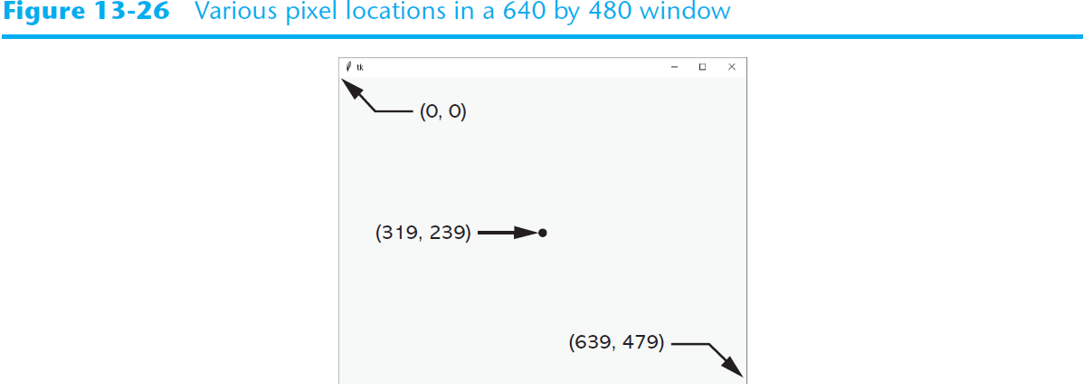
Drawing Shapes with the Canvas Widget

Slide 60
Drawing Shapes with the Canvas Widget
Creating a Canvas widget:
# Create the main window.
self.main_window = tkinter.Tk()
# Create the Canvas widget.
self.canvas = tkinter.Canvas(self.main_window, width=200, height=200)

Slide 61
Drawing Shapes with the Canvas Widget
The Canvas widget has numerous methods for drawing graphical shapes on the surface of the widget.
The methods that we will discuss are:
  create_line
  create_rectangle
  create_oval
  create_arc
  create_polygon
  create_text

Slide 62
Drawing a Line
Coordinates of
the line's ending
point
canvas_name.create_line(x1, y1, x2, y2, options…)
Coordinates of
the line's starting
point
Optional arguments
(See Table 13-2)

Slide 63
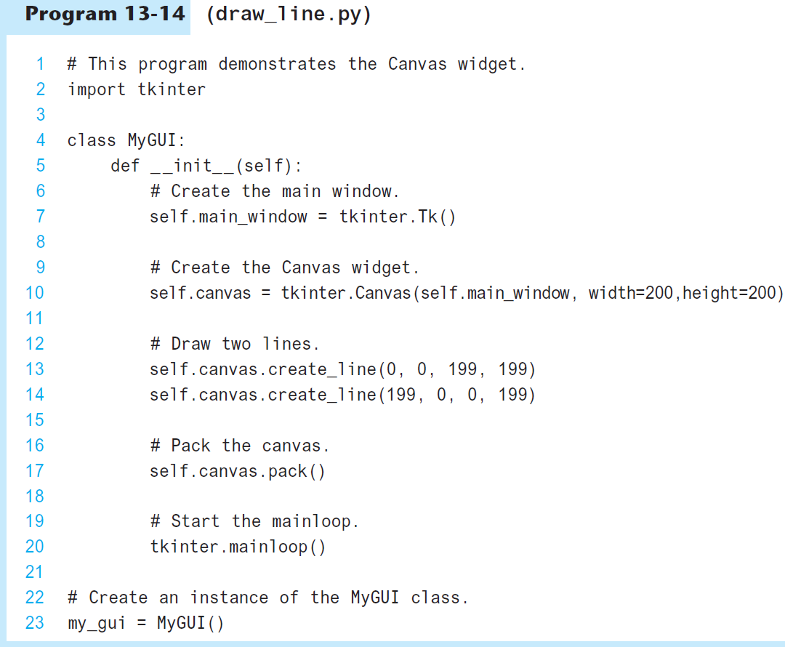
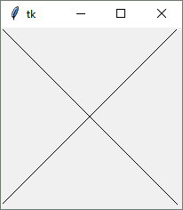

Slide 64
Drawing a Rectangle
Coordinates of
the lower-right
corner
canvas_name.create_rectangle(x1, y1, x2, y2, options…)
Coordinates of
the upper-left
corner
Optional arguments
(See Table 13-3)

Slide 65
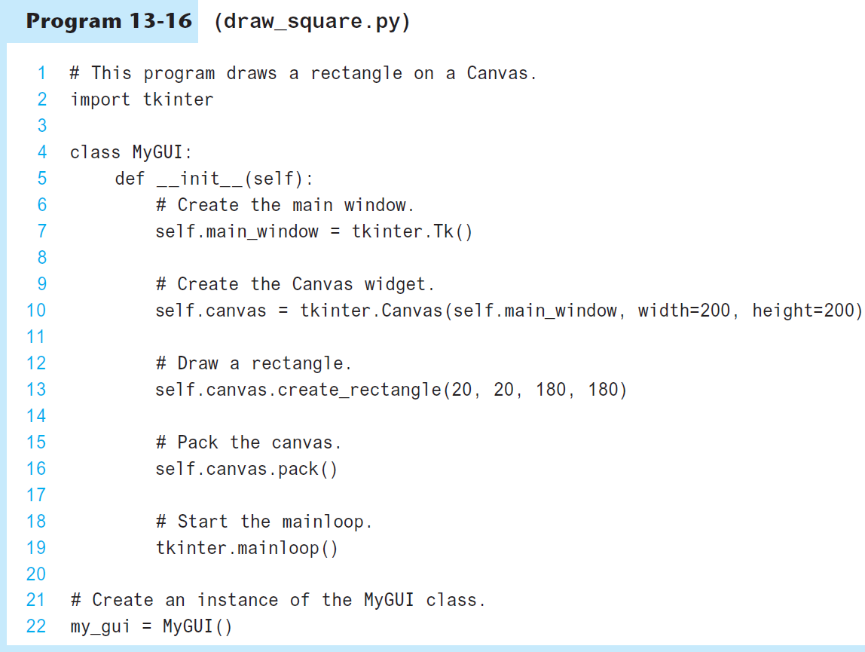
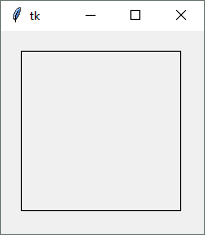

Slide 66
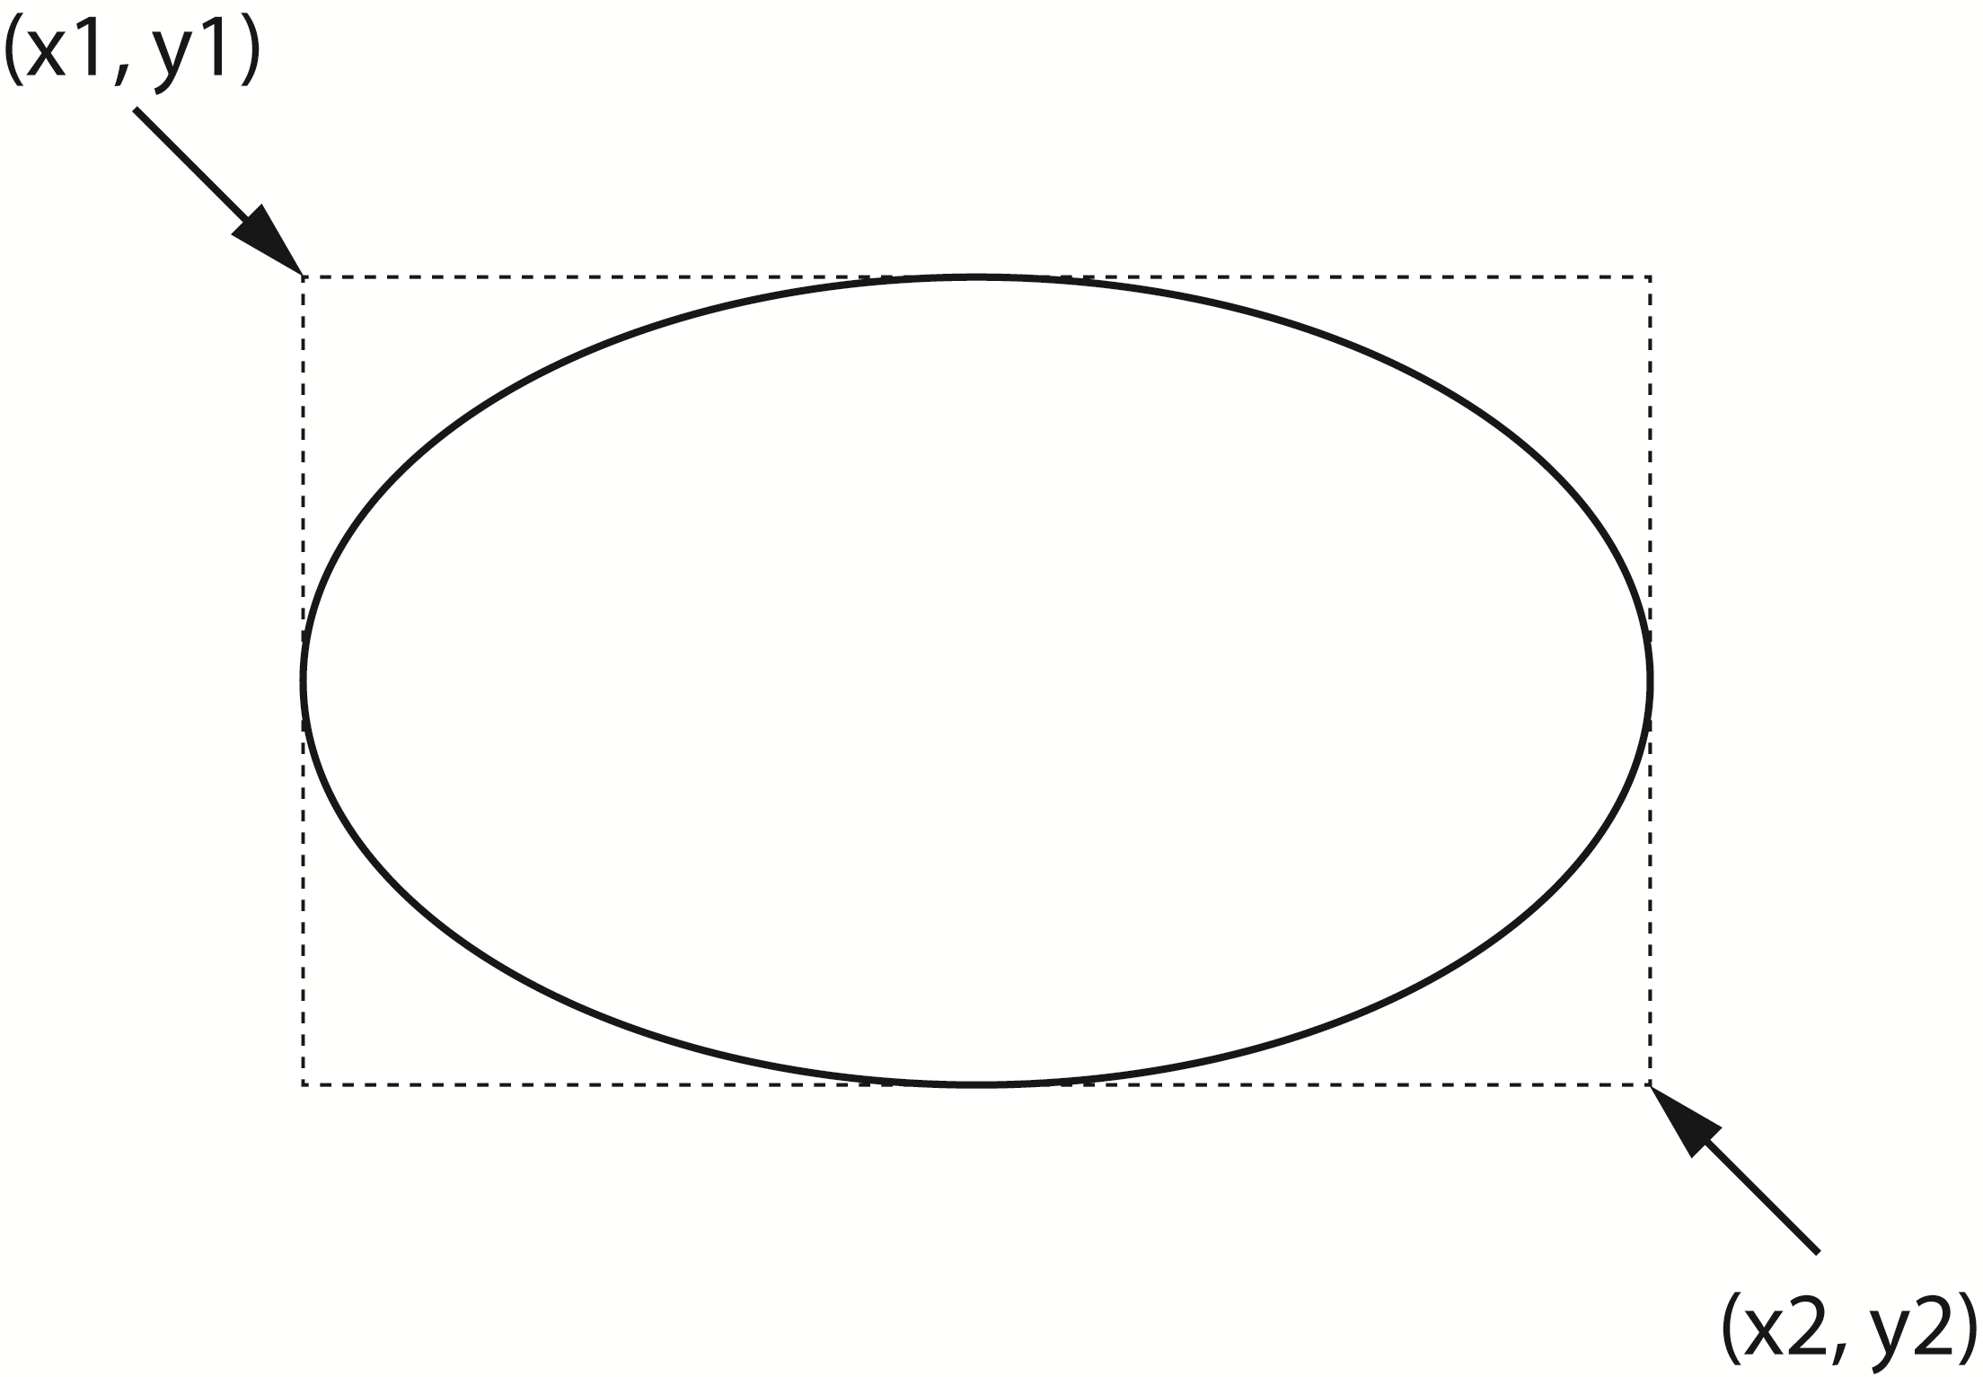
Drawing an Oval
Coordinates of
the lower-right
corner of
bounding rectangle
canvas_name.create_oval(x1, y1, x2, y2, options…)
Coordinates of
the upper-left
corner of
bounding rectangle
Optional arguments
(See Table 13-4)

Slide 67
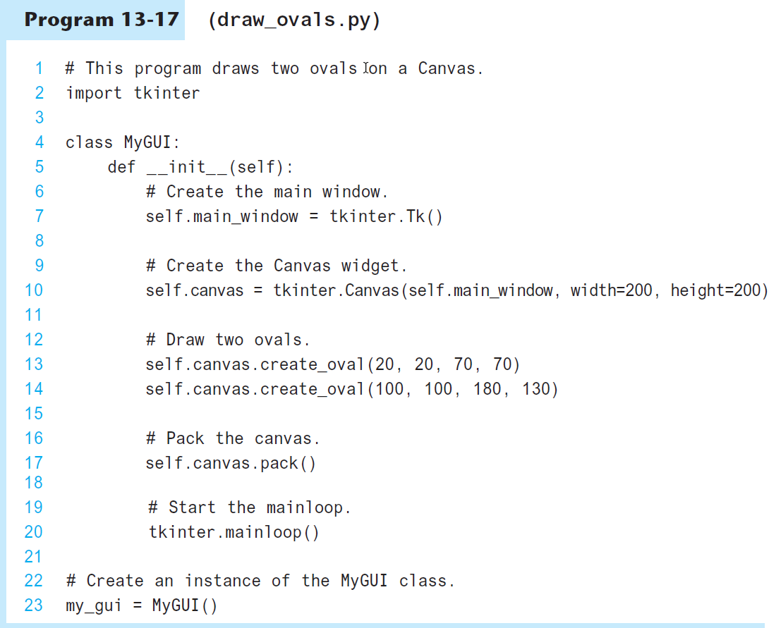
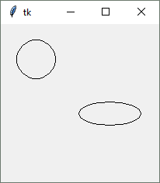

Slide 68
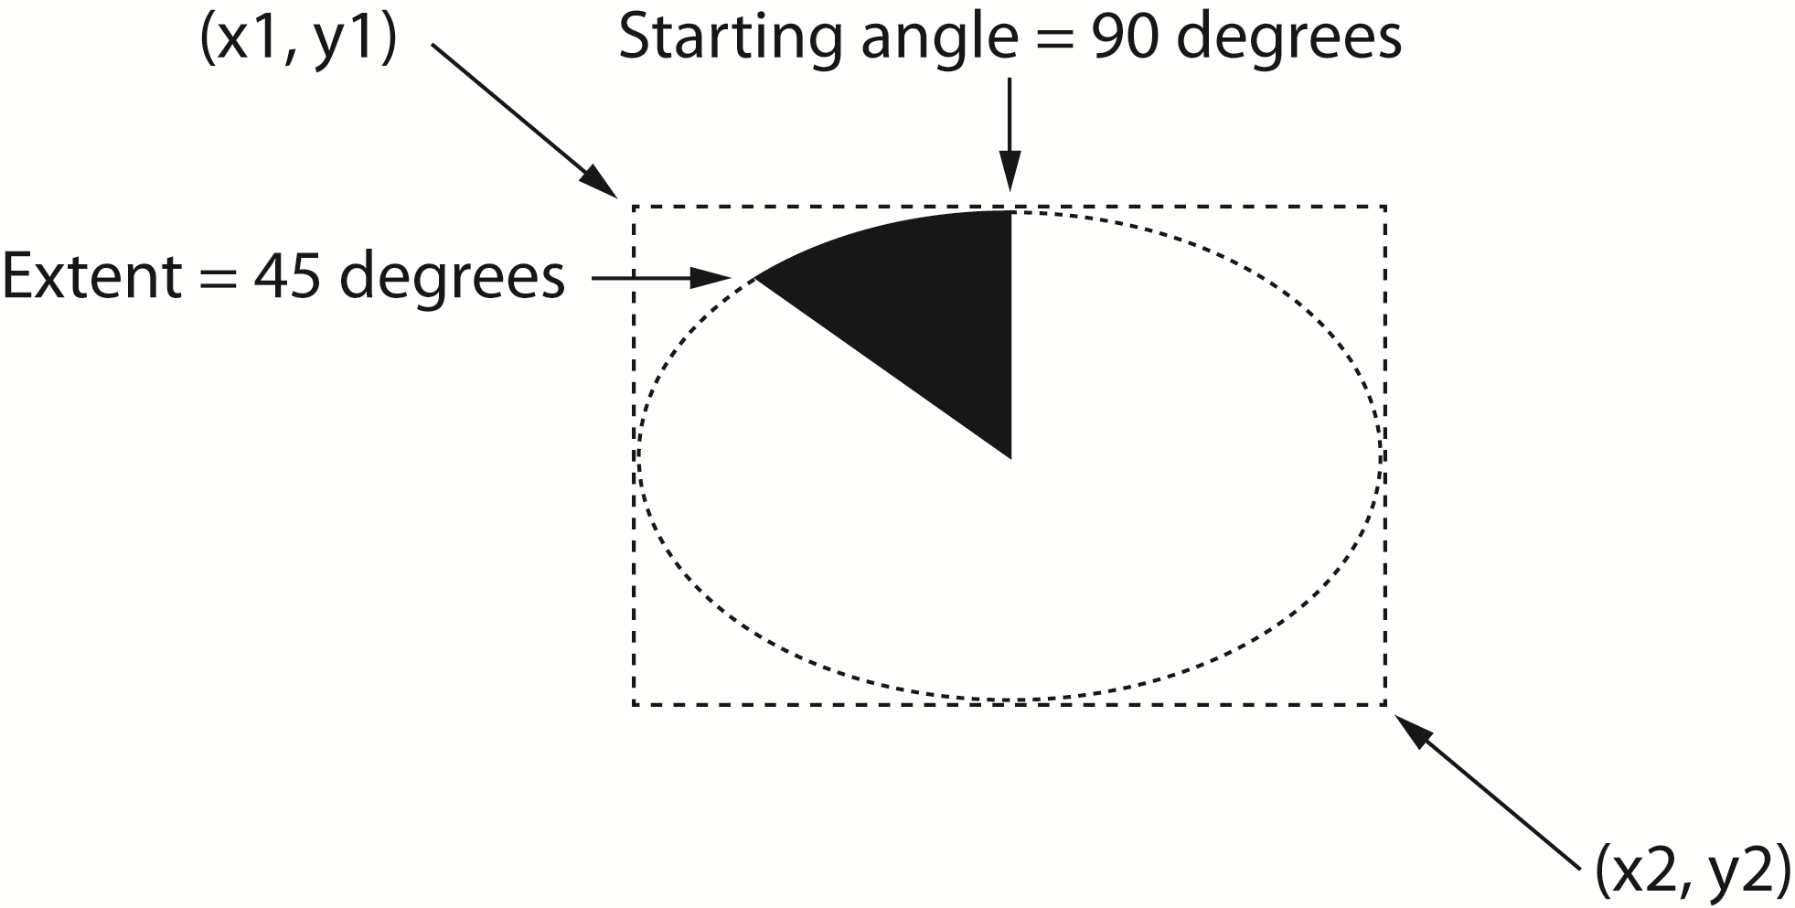
Drawing an Arc
Coordinates of
the upper-left
corner of
bounding rectangle
Coordinates of
the lower-right
corner of
bounding rectangle
canvas_name.create_arc(x1, y1, x2, y2,
start=angle, extent=width,
options…)
Starting angle
Counter clockwise
extent of the arc
Optional arguments
(See Table 13-5)

Slide 69
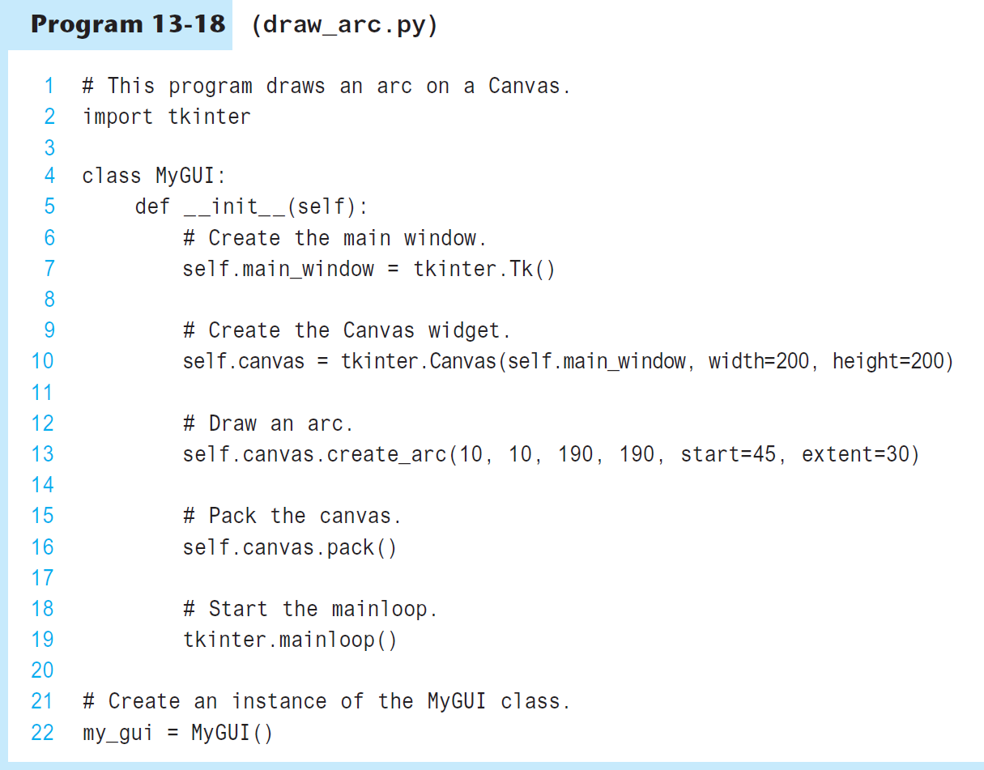
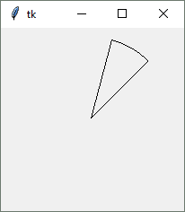

Slide 70
Drawing a Polygon
Coordinates of
the second vertex
canvas_name.create_polygon(x1, y1, x2, y2, …,options…)
Coordinates of
the first vertex
Optional arguments
(See Table 13-7)

Slide 71
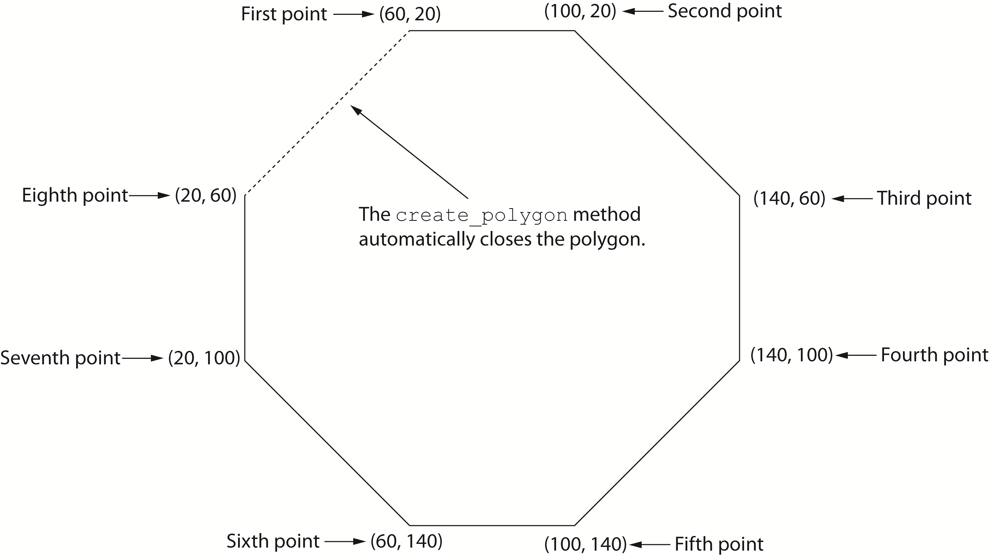
Drawing a Polygon
self.canvas.create_polygon(60, 20, 100, 20, 140, 60, 140, 100,
100, 140, 60, 140, 20, 100, 20, 60)

Slide 72
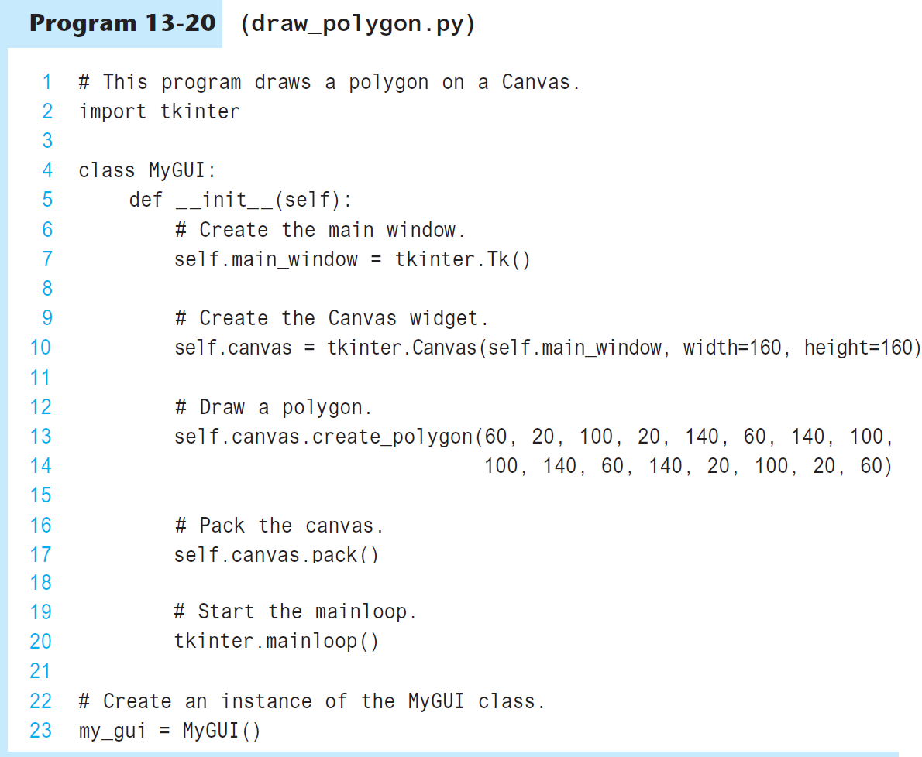
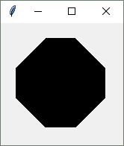

Slide 73
Displaying Text on the Canvas
Text to display
canvas_name.create_text(x, y, text=text, options…)
Coordinates of
the text's insertion
point
Optional arguments
(See Table 13-8)

Slide 74
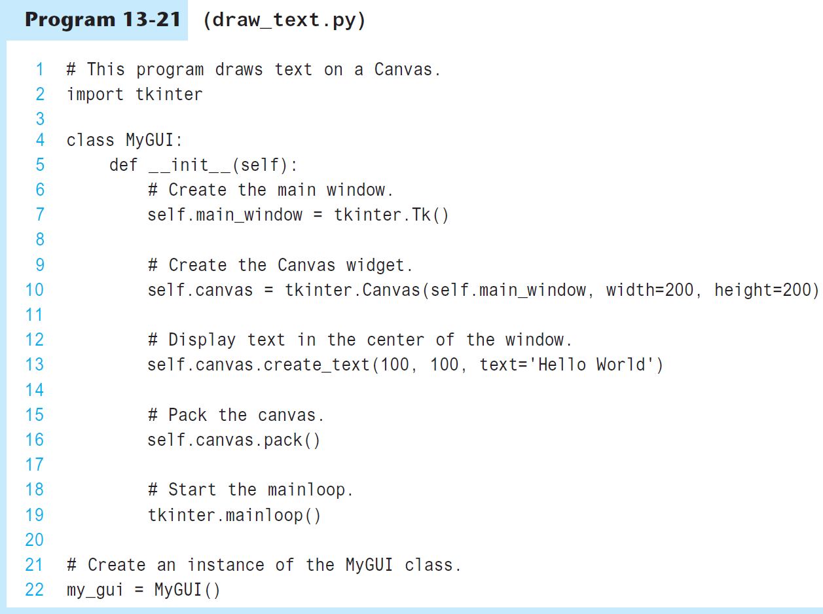
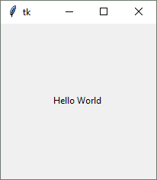

Slide 75
Summary
This chapter covered:
  Graphical user interfaces and their role as event-driven programs
  The tkinter module, including:
    Creating a GUI window
    Adding widgets to a GUI window
    Organizing widgets in frames
    Receiving input and providing output using widgets
    Creating buttons, check buttons, and radio buttons
    Drawing simple shapes with the Canvas widget

